Slide 1
Luria-Delbrück Experiment: Model Comparison Report
Yuval Koren & Bar Cohen
3.4.2025 Evolution through programming

Slide 2
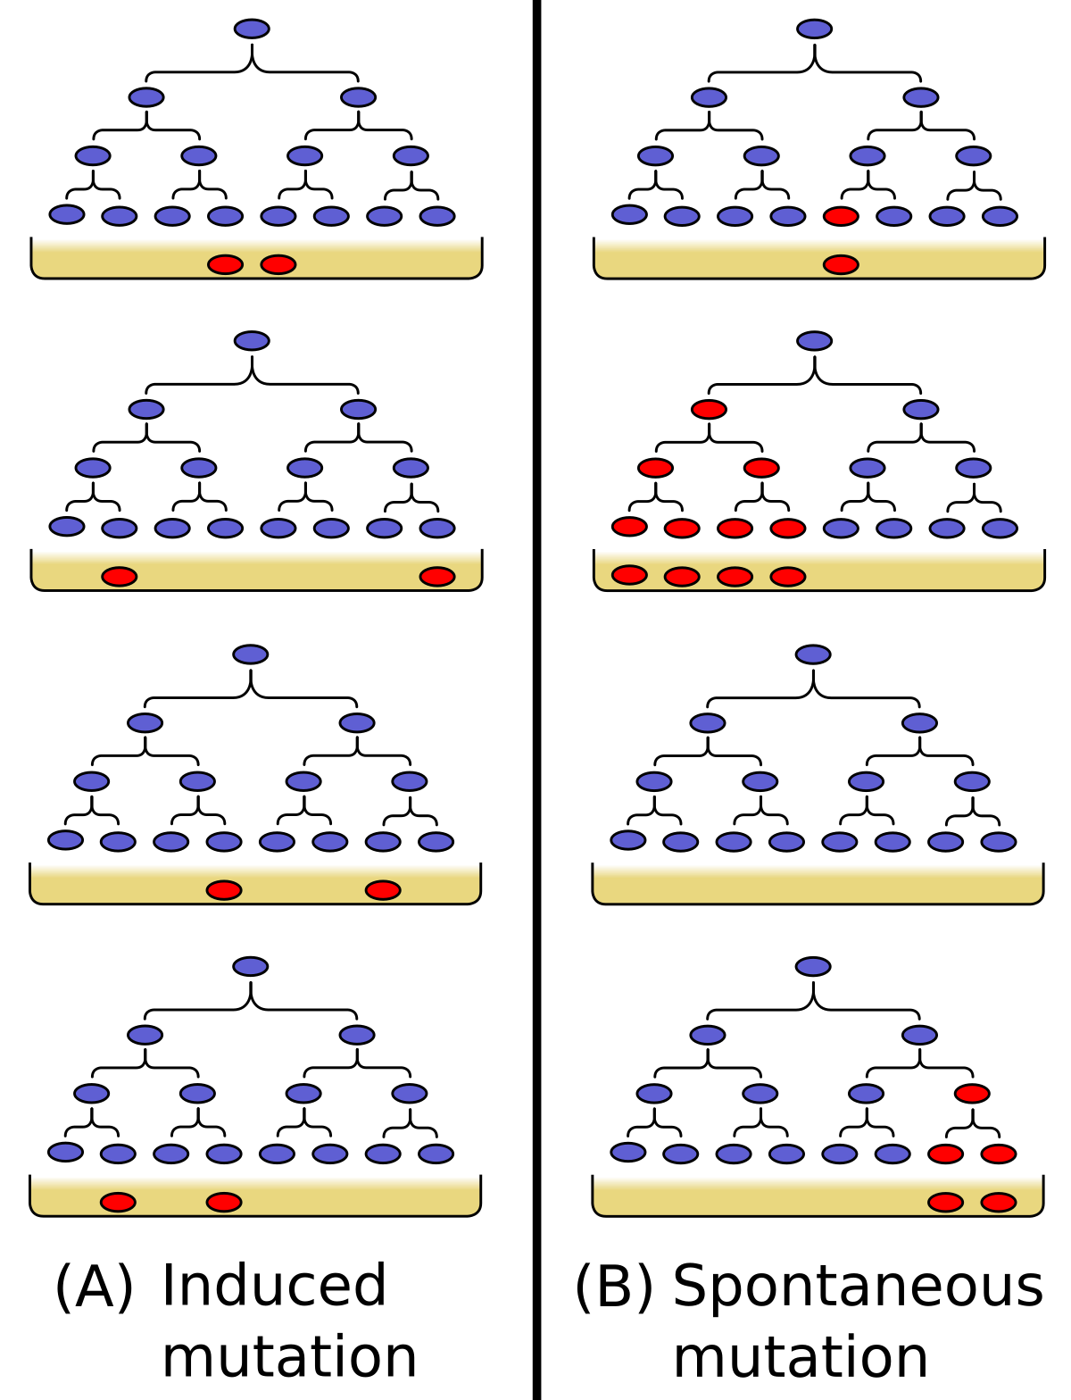
Theoretical assumption
Two competing hypotheses:
Darwinian (Random) Mutation: Mutations occur spontaneously during bacterial growth, independent of selective pressure
Lamarckian (Induced) Mutation: Mutations arise as a direct response to selective pressure

Slide 3
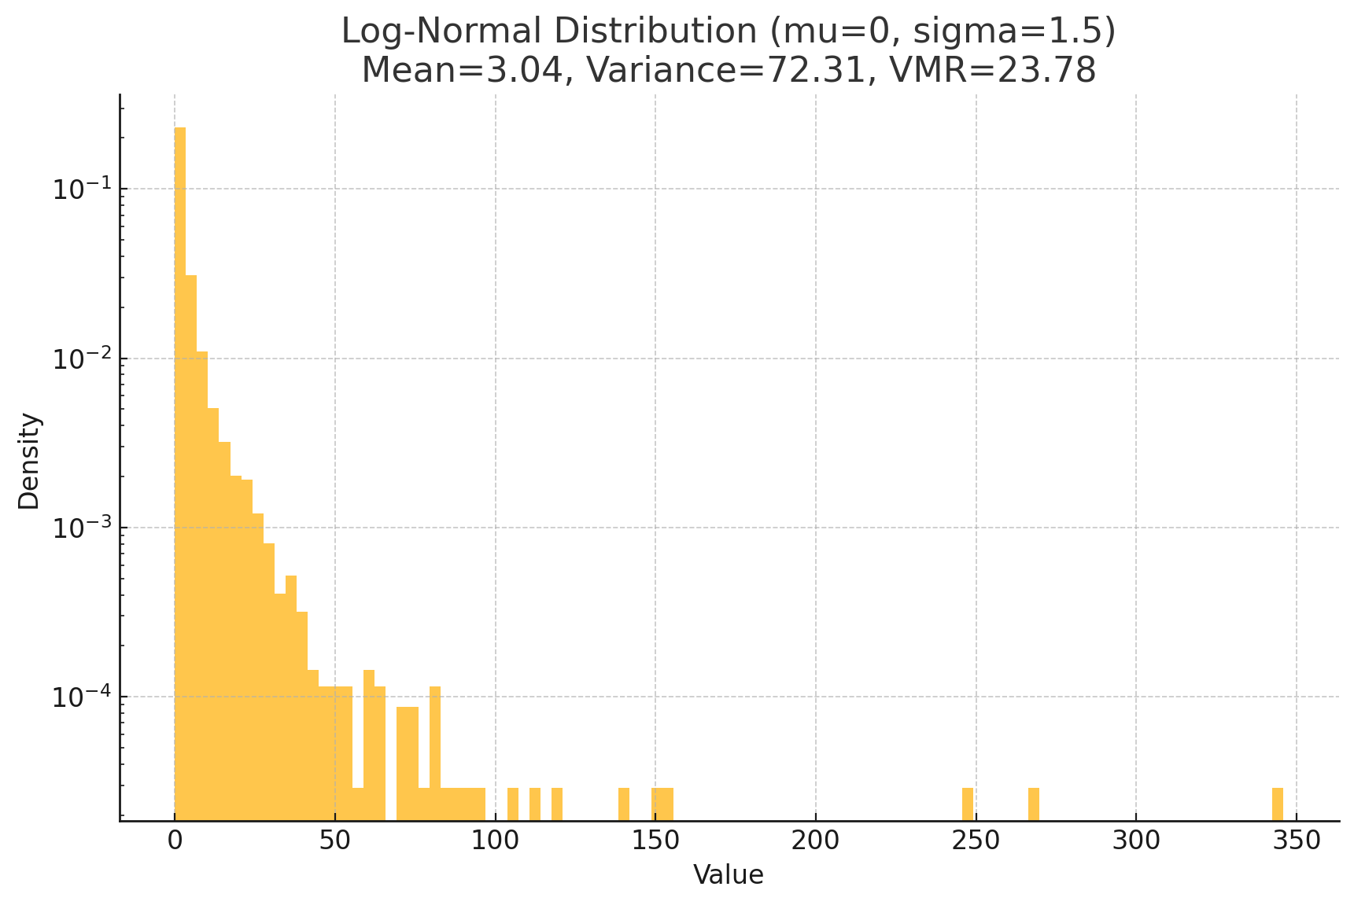
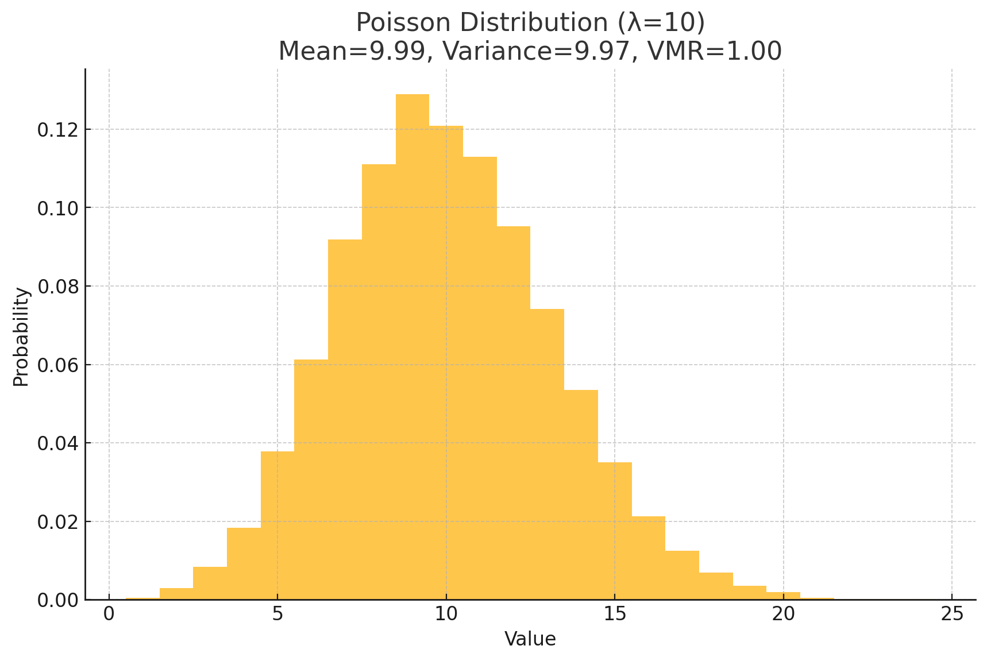
Mathematical implications
Random model: Variance > Mean (Variance-to-Mean Ratio > 1)
Highly skewed, heavy-tailed distribution
Negative Binomial distribution or a Log-Normal distribution
Induced model: Variance ≈ Mean (Variance-to-Mean Ratio ≈ 1)
Poisson distribution
Notes:
The Luria-Delbrück experiment has several important mathematical implications that help distinguish between random mutation and induced mutation models. Let me explain the key mathematical aspects:
Variance-to-Mean Ratio (VMR): This is the critical statistical indicator in the experiment.
In the random mutation model, VMR > 1 (overdispersion)
In the induced mutation model, VMR ≈ 1 (Poisson distribution)
Distribution Shape:
Random mutation produces a highly skewed, heavy-tailed distribution (often following the Luria-Delbrück distribution)
Induced mutation follows a Poisson distribution (symmetrical, light-tailed)
Fluctuation Test Implications: The random mutation model predicts high variance between cultures because mutations occur randomly during growth, leading to "jackpot" cultures with many mutants.
Mathematical Foundations:
The random mutation model aligns with stochastic processes and can be modeled using branching processes
The induced mutation model follows more deterministic statistical patterns
Mutation Rate Estimation: The mathematics allows calculation of mutation rates using the P0 method (fraction of cultures with zero mutants) or using the method of moments based on the distribution parameters.
These mathematical implications were revolutionary because they provided a statistical framework to distinguish between competing biological theories, establishing a powerful connection between mathematics and evolutionary biology.

Slide 4
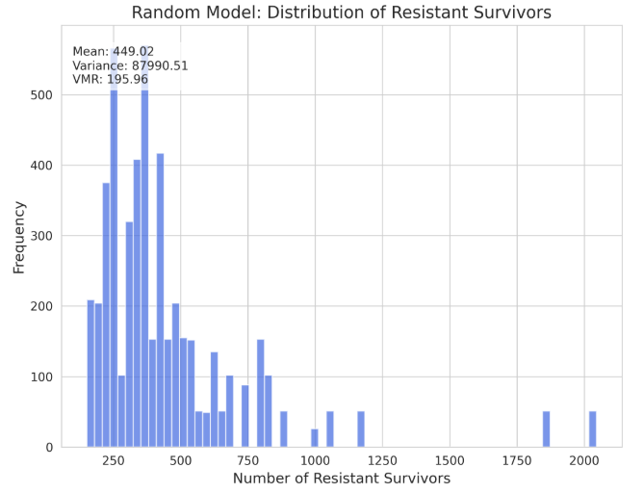
Random Mutation result in heavy-tail distribution

Slide 5
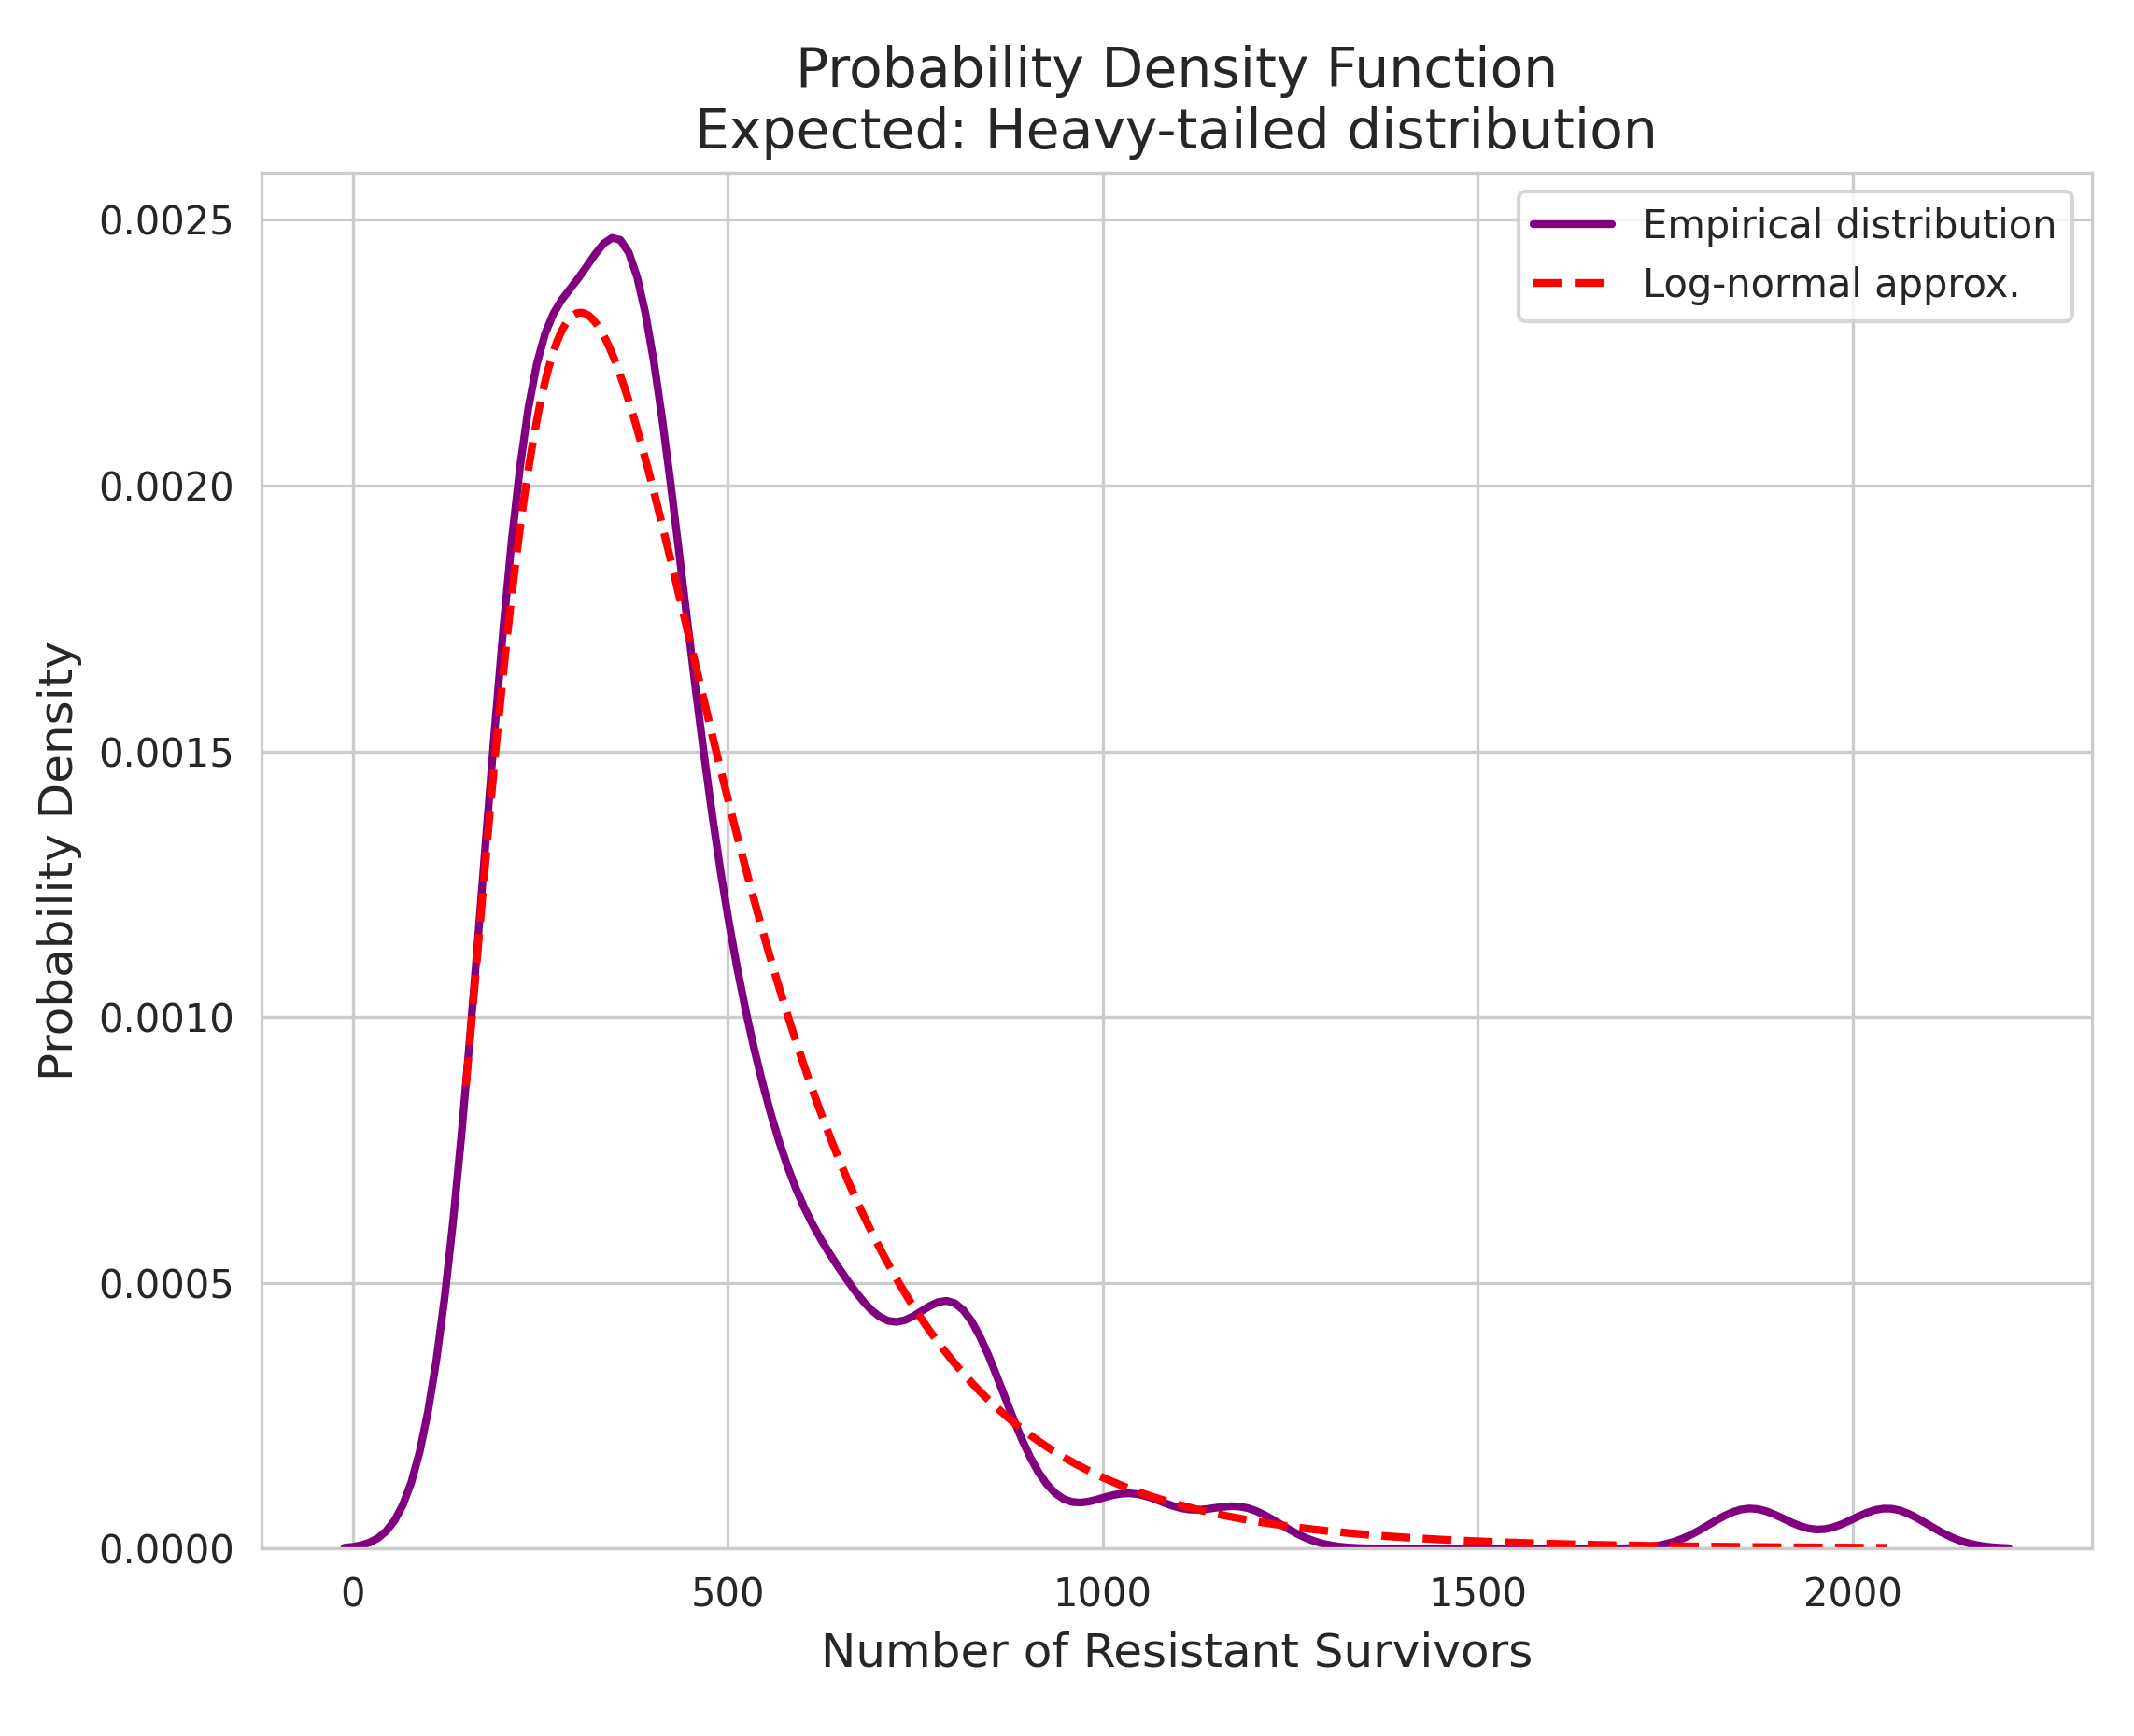
Random Mutation result in heavy-tail distribution

Slide 6
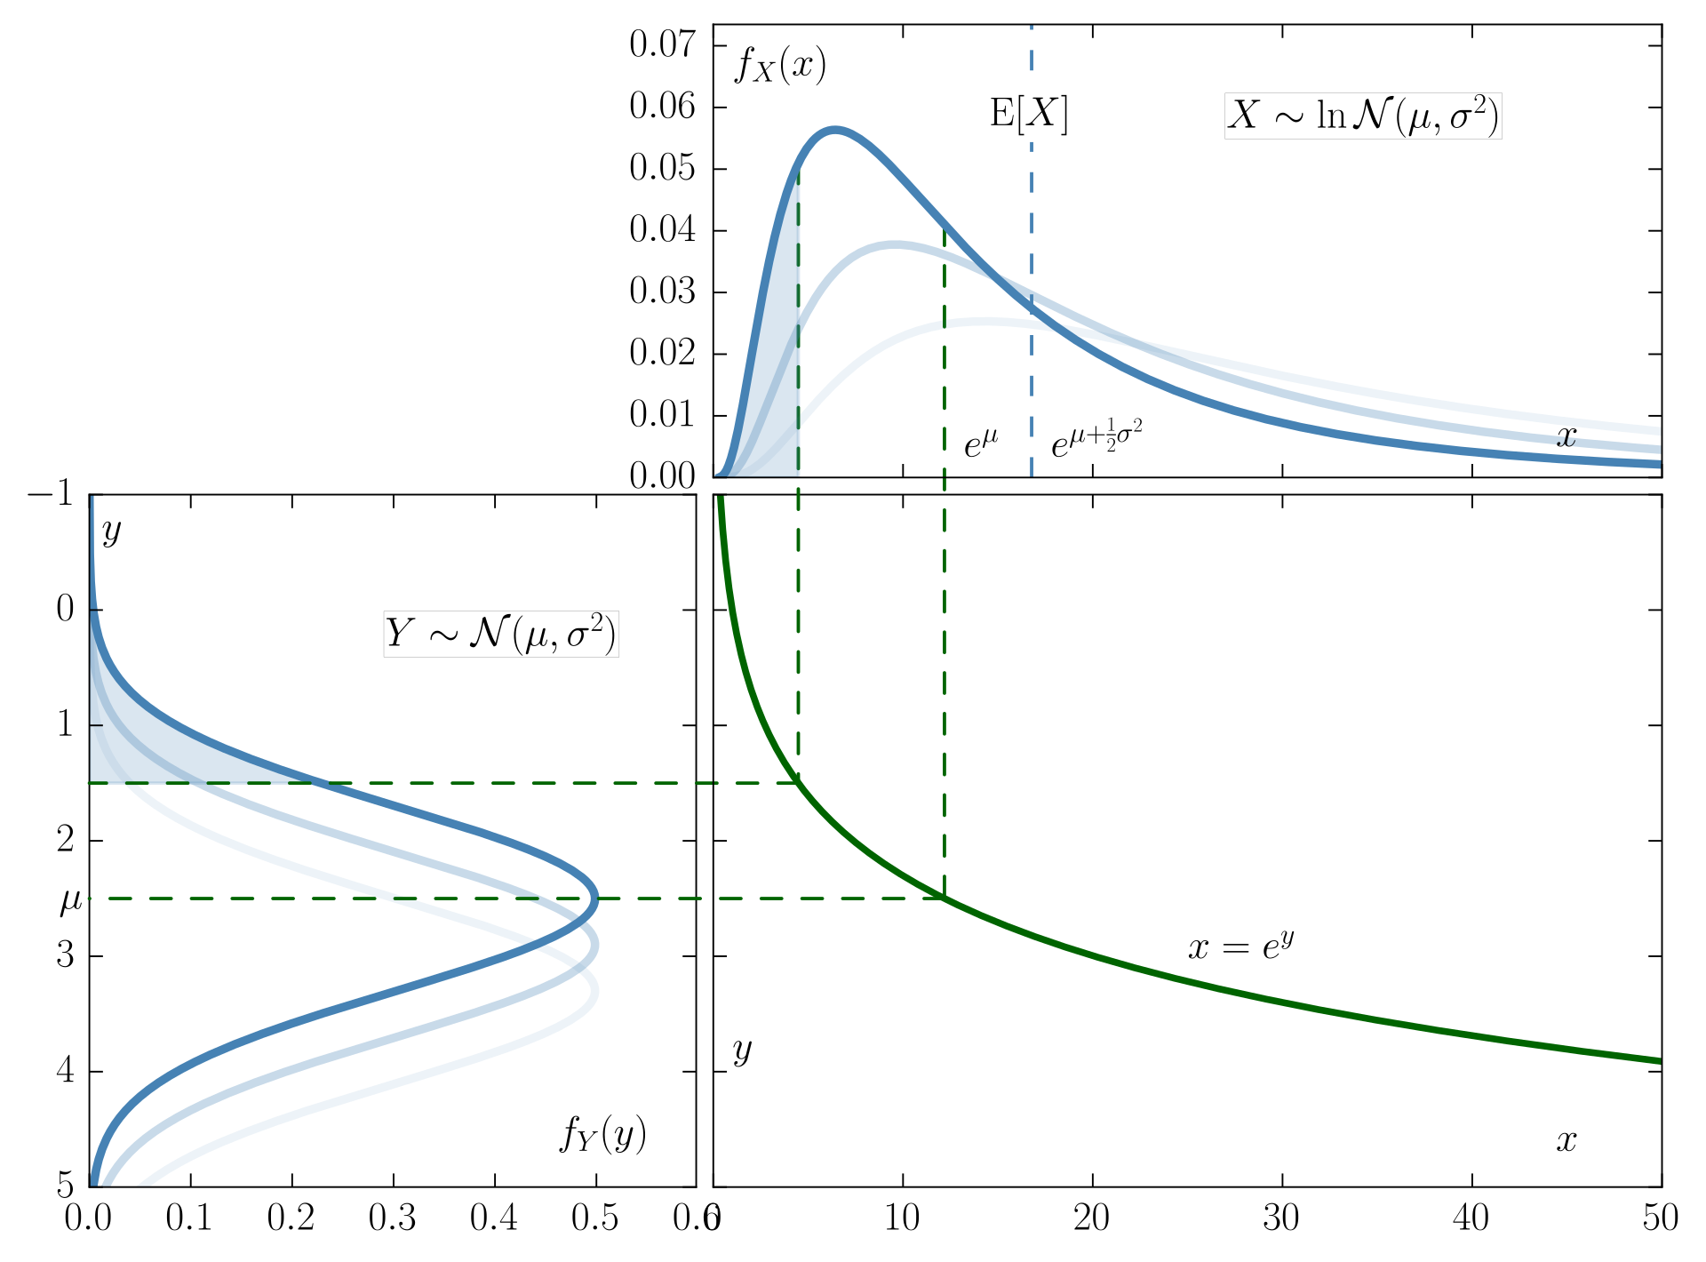
The Log-Normal distribution
The probability dist. of a random variable whose logarithm is normally distributed

Slide 7
The Log-Normal distribution – why? An intuition
Random variable whose logarithm is normally distributed
Why?
Most of mutant bacteria in the last generation are from the first mutation
(If we have mutation in gen. 3 and in gen. 7, we can neglect gen. 7 offsprings)
How does the generation of first mutation distribute?
Binomial!
~Normal!
So last generation has ~2^k mutants, with k normally distributed
Log-normal ☺

Slide 8
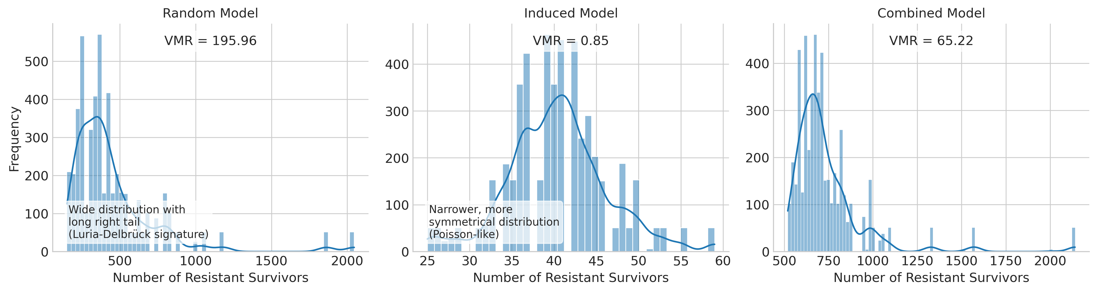
Random , Induced and Combined model presenting different types of distributions

Slide 9
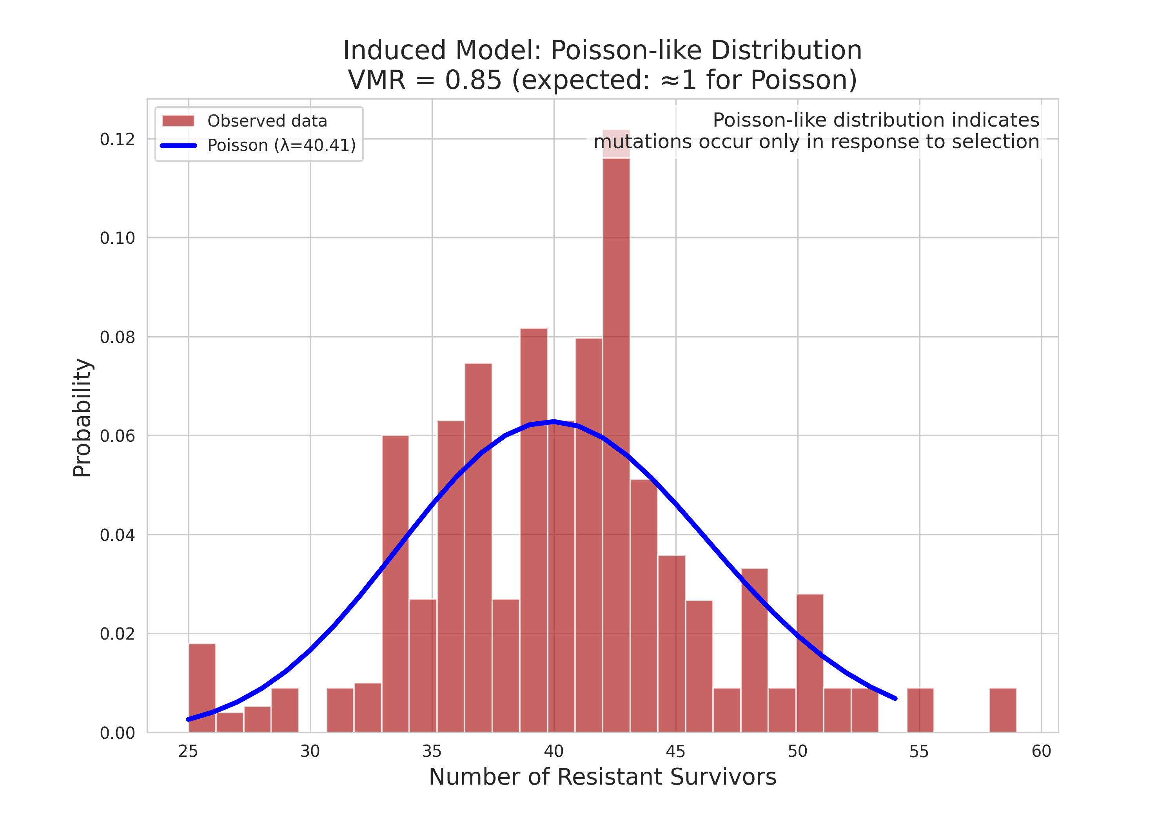
Induced Mutation – Poisson distribution

Slide 10
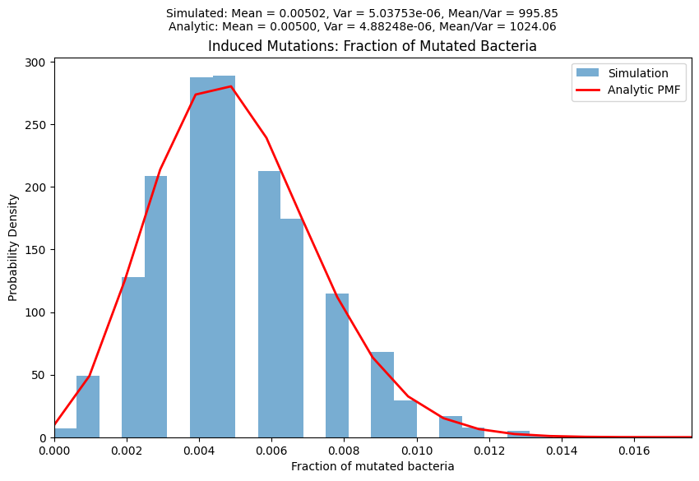
Induced Mutation – Poisson distribution

Slide 11
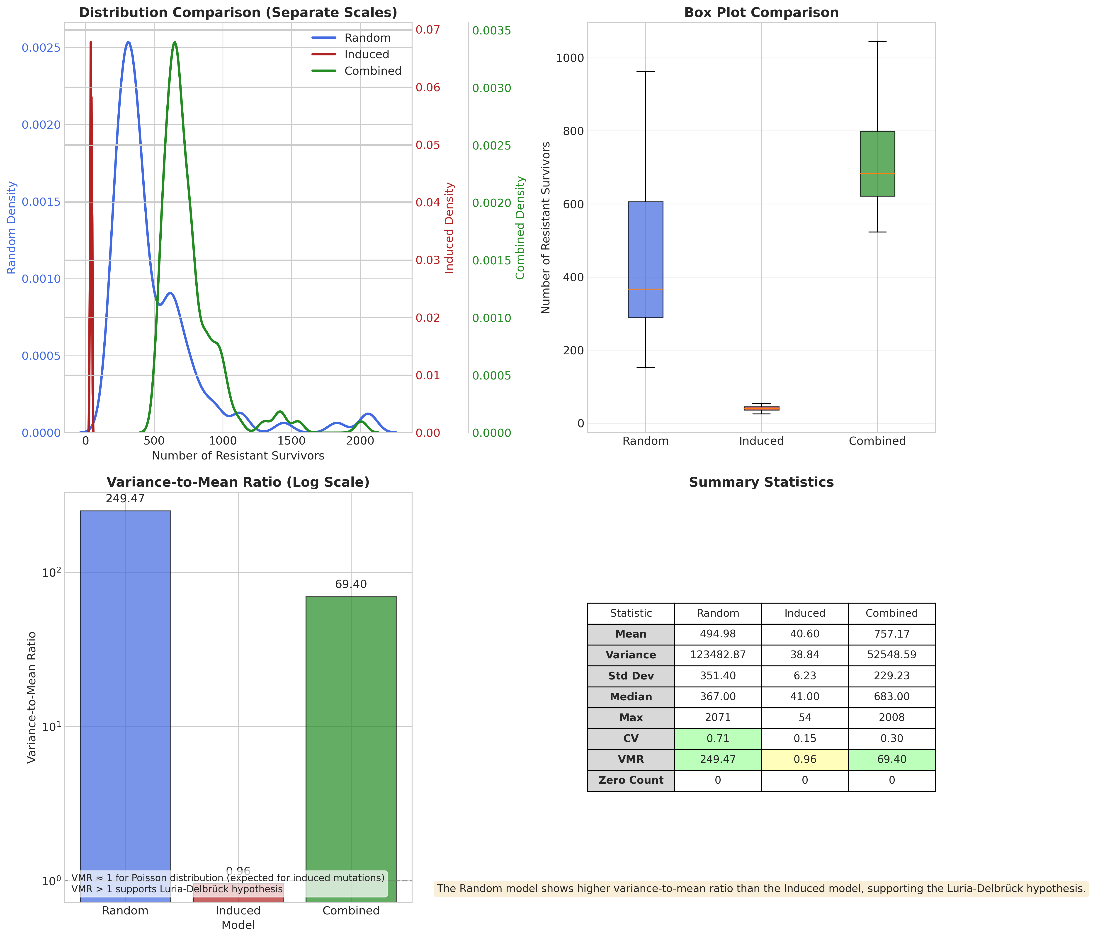
Variance/ mean ratio helps to distinguish between models

Slide 12
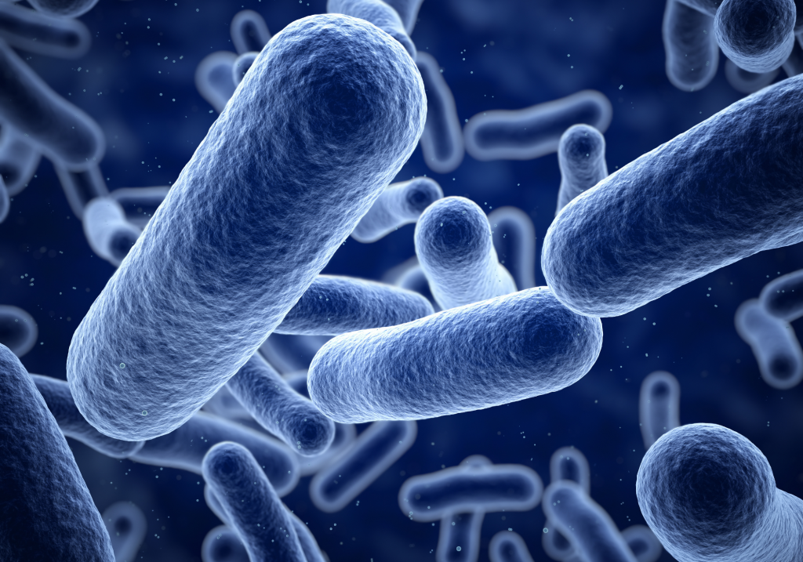
Questions?

